Slide 1
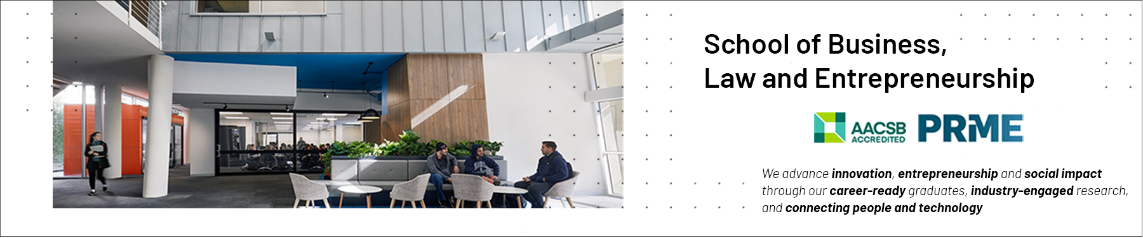

Ethical Theories/Principles/Frameworks
School of Business, Law and Entrepreneurship
Online Learning Materiel

Slide 2
Objectives of the Ethical Theory Presentation
Be able to integrate critical analysis with ethical evaluation.
Understand the difference between applied ethics (Code of Conduct) and Normative Ethics (right or wrong) in helping us decide how to act.
Consider different ethical approaches (theories) in ethical analysis.
Explore new ethical thinking we need to incorporate in order to address global challenges.

Slide 3
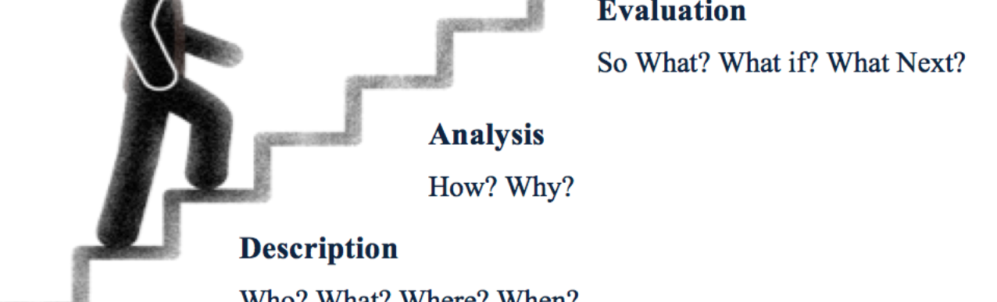
Introducing Critical Analysis into Ethical Reasoning
“We engage in moral reasoning when we make a decision about what we ought or ought not to do, or about what is the most reasonable or just position regarding a particular issue. Effective moral decision-making depends on good critical-thinking skills….” (Boss, J. 2010 p. 275).
Critical Analysis Framework - A very useful tool (F).pdf
Notes:
The aim is to have you engage in moral reasoning with the aim of developing your ability to contribute to effective ethical decision-making in your professional life.

Slide 4
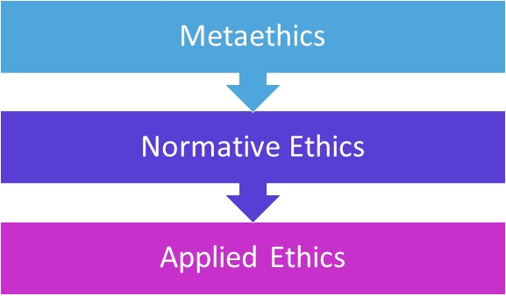
A brief Framework of Moral Philosophy

Slide 5
Normative Ethics:
The act itself… RIGHTS and DUTIES APPROACHES
The person performing the act… VIRTUE APPROACHES
The consequences of the act… CONSEQUENTIALISM

Slide 6
Normative Ethics: Consequentialism Ethics
Consequentialism: An action is morally right if the consequences of that action are more favorable than unfavorable.
Utilitarianism: an action is right if it brings about the greatest happiness and the least amount of pain or unhappiness.
Weaknesses?

Slide 7
Normative Ethics: Rights and Duties
Rights and Duties: two golden principles:
treat people as if they are valuable for their own sakes.
treat others as you would like to be treated.
Rights and Duties ethics treats everyone equally and embraces justice as an absolute goal.
Duty-based Ethics:
Rights based ethics:
Weaknesses?

Slide 8
Normative Ethics: Virtue Ethics
Virtue Ethics: Certain traits (honesty, compassion, generosity, courage), are seen as virtues. Acquiring these virtues will guide our decisions about how to act, even in difficult situations.
Virtue Ethics: What kind of person do I want to be?
Weaknesses?
Notes:
advice8

Slide 9
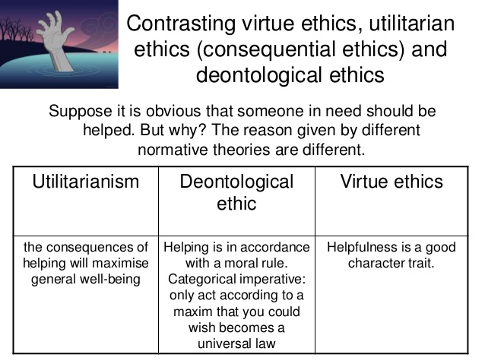
Introducing Critical Analysis into Ethical Reasoning

Slide 10
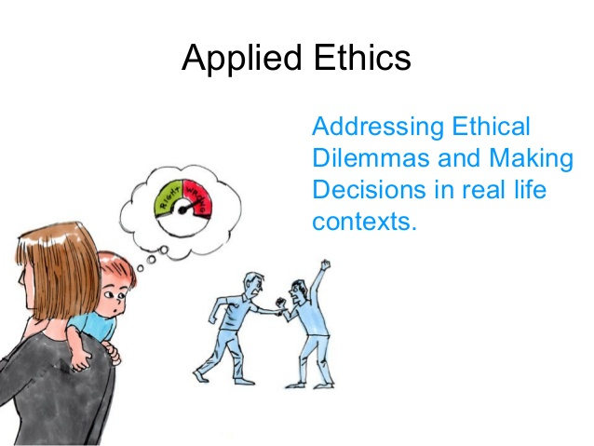
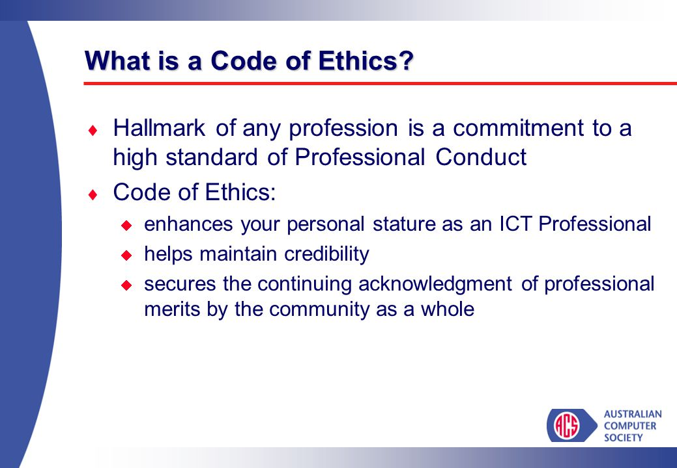
Applied Ethics

Slide 11

My Ethical Toolbox

Slide 12
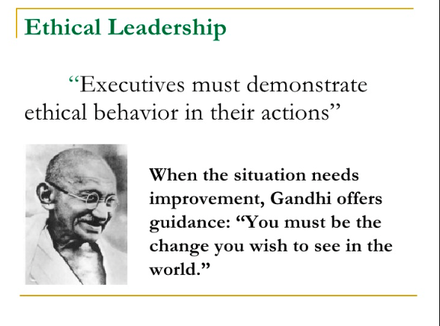

Slide 13
Summary
Ethical deliberation is not normally associated with ICT design and use, and it needs to be
Ethics in business is becoming more important because the risks associated with inappropriate behaviour have grown
Corporations want to protect themselves and their employees from legal action
Information ethics is now a distinct area of study
There are some challenging ethical issues introduced through ICT advancement
As an ICT professional you need to understand the potential impact of your decisions.
You need to develop an ethical toolbox to help you make ethically informed decisions.
Notes:
13

Slide 14


